Slide 1
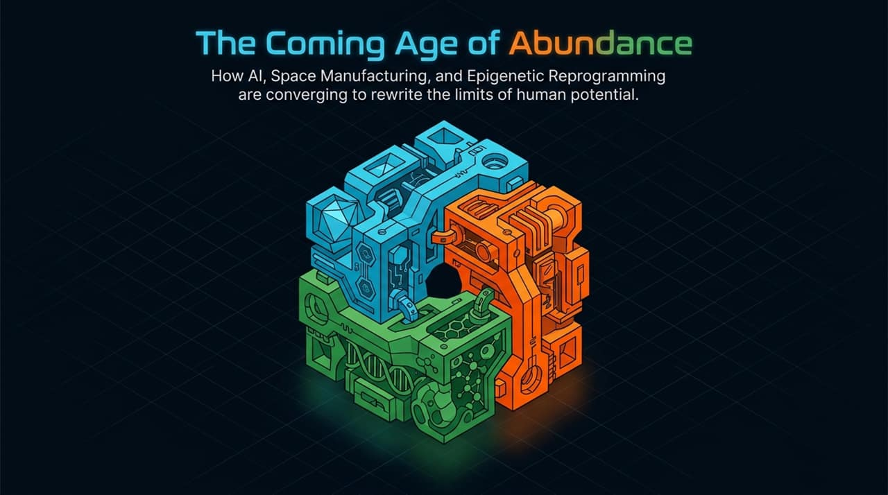
Notes:
Introduction & Hook:
Welcome, everyone. Today, we are stepping back to look at the macro trajectory of technological progress. Throughout history, human capability has been constrained by physical, computational, and biological limits. But we are entering an unprecedented era where these bottlenecks are falling simultaneously.
Core Thesis:
The 'Age of Abundance' is not just a vague optimistic vision—it is an engineering reality driven by three converging pillars: Artificial Intelligence, Space Manufacturing, and Epigenetic Reprogramming.
Framing the Convergent Arc:
Individually, each of these fields promises multi-trillion-dollar breakthroughs. Together, they create a compounding flywheel. When you combine infinite compute, infinite physical resources, and extended, healthy human time, the baseline economics of society fundamentally change.
Transition:
Let’s start by analyzing how these three revolutions shatter our existing bottlenecks.
https://www.youtube.com/watch?v=R6UVuDCTd7A

Slide 2
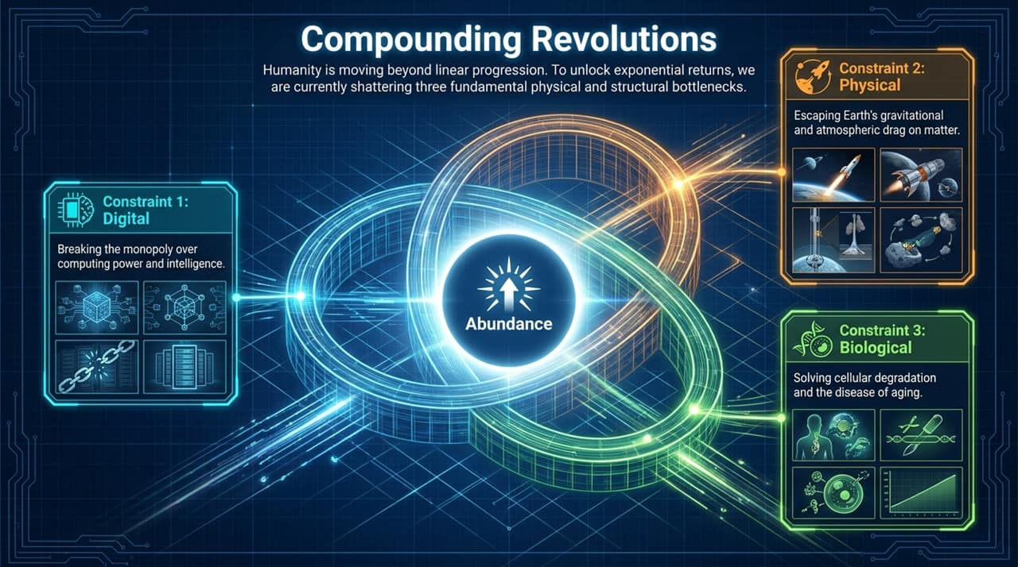
Notes:
Moving Beyond Linear Thinking:
To understand where we are going, we first have to identify what is holding us back today. Historically, progress has been linear because humanity constantly hits hard physical and structural walls.
Breakdown of the 3 Constraints:
Constraint 1: Digital (Compute Monopolies): We currently face a bottleneck around centralization—where a handful of tech giants control high-performance compute and data centers.
Constraint 2: Physical (Gravity & Atmospheric Drag): On Earth, manufacturing and logistics are shackled by $1G$gravity and heavy atmospheric drag, making off-world expansion absurdly expensive under traditional rocketry.
Constraint 3: Biological (Cellular Degradation): Biologically, human productivity and life are capped by cellular aging, which manifests as systemic disease and functional decline over time.
The Abundance Flywheel:
Overcoming these limits sequentially was the story of the 20th century. Overcoming them simultaneously is the story of the 21st century.
Transition:
Let’s dive into Pillar 1: breaking the digital constraint through the diffusion of intelligence.

Slide 3
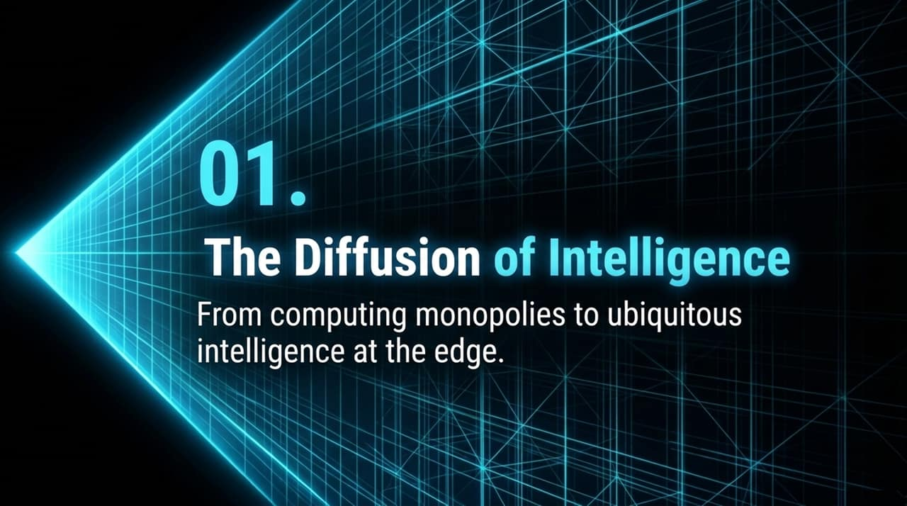
Notes:
Overview:
When a revolutionary technology first emerges, it naturally centralizes. Early adopters and deep-pocketed infrastructure owners capture the vast majority of the initial value.
Macro Perspective:
Many commentators today fear that artificial intelligence will remain locked inside $100 billion mega-data centers owned by two or three tech conglomerates.
The Core Argument:
History demonstrates the exact opposite: technology inherently diffuses. What begins as an expensive central monopoly rapidly commoditizes and moves to the edge, putting power directly into the hands of end users.
Transition:
Let’s look at a concrete historical parallel from the early internet era to see how this plays out.

Slide 4
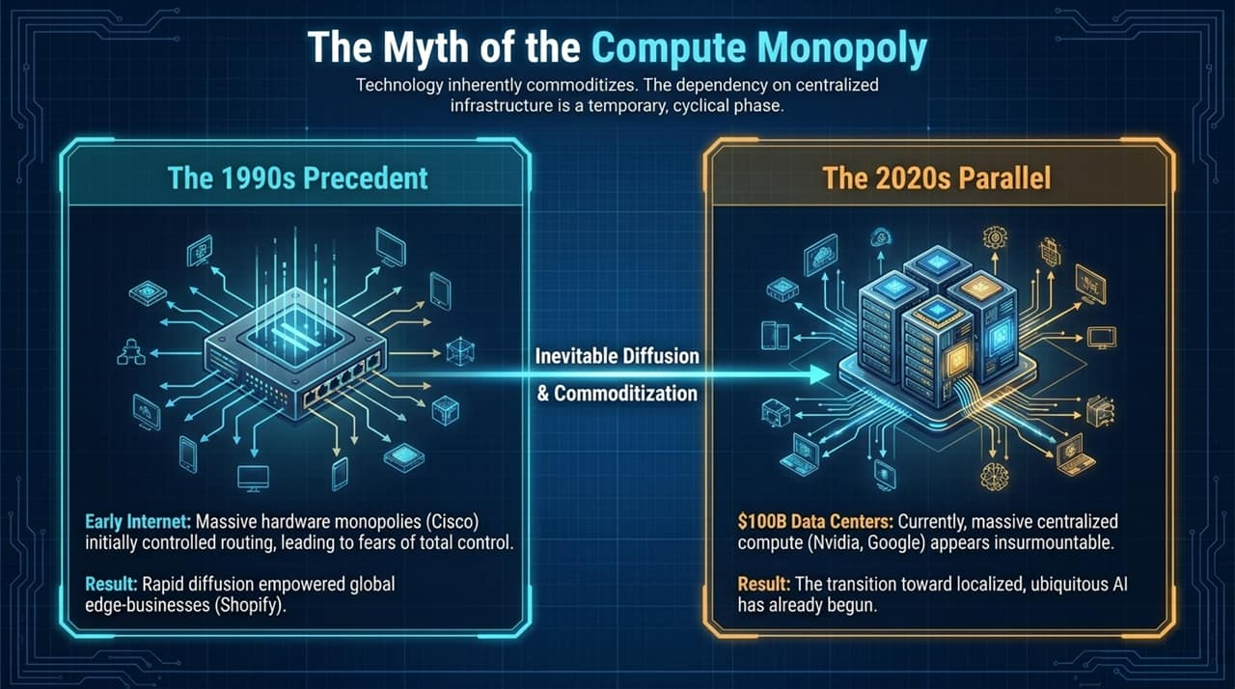
Notes:
The 1990s Internet Precedent:
In the 1990s, early critics believed Cisco and a few telecom giants would permanently own and control the internet because they built the physical switches and routers.
People feared that no smaller entity could ever compete against those hardware monopolies.
What actually happened? As bandwidth and routing tech commoditized, value moved outward. Decades later, platforms like Shopify enabled individual entrepreneurs to set up global e-commerce storefronts in minutes from their bedrooms.
The 2020s Parallel (Nvidia, Google, Big Tech):
Today, we see the exact same panic around Nvidia’s GPUs and tech giants spending tens of billions on mega data centers.
While central infrastructure dominates the early phase of AI, localized intelligence is already accelerating faster than anticipated.
Takeaway:
Data centers are an early-stage requirement, not the ultimate destination. Intelligence will sit ubiquitously on your phone, laptop, and local hardware.

Slide 5
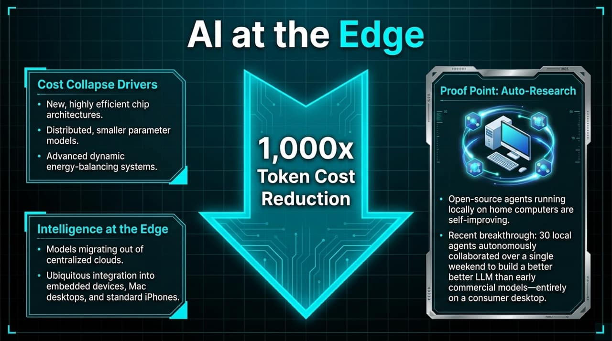
Notes:
Cost Collapse Drivers:
Why is cloud dependency breaking down so quickly? Because token costs are collapsing by $1,000×$.
This massive cost reduction is driven by three main innovations:
Highly efficient, novel chip architectures.
Smaller parameter, highly optimized distributed models.
Dynamic energy-balancing systems that maximize hardware throughput.
Intelligence at the Edge:
Instead of sending every request to a cloud data center, lightweight models are running natively on consumer Macs, standard iPhones, and embedded IoT devices.
Case Study: Auto-Research:
Consider Andrej Karpathy's recent 'Auto-Research' experiment. Over a single weekend, 30 open-source AI agents ran locally on a home desktop.
They autonomously collaborated, scored each other's code modifications, and iterated to build an improved LLM—outperforming earlier commercial cloud models, all on consumer hardware.
Key Takeaway:
Local auto-improving intelligence proves that hardware constraints will not stop individual creators from building state-of-the-art AI applications.

Slide 6
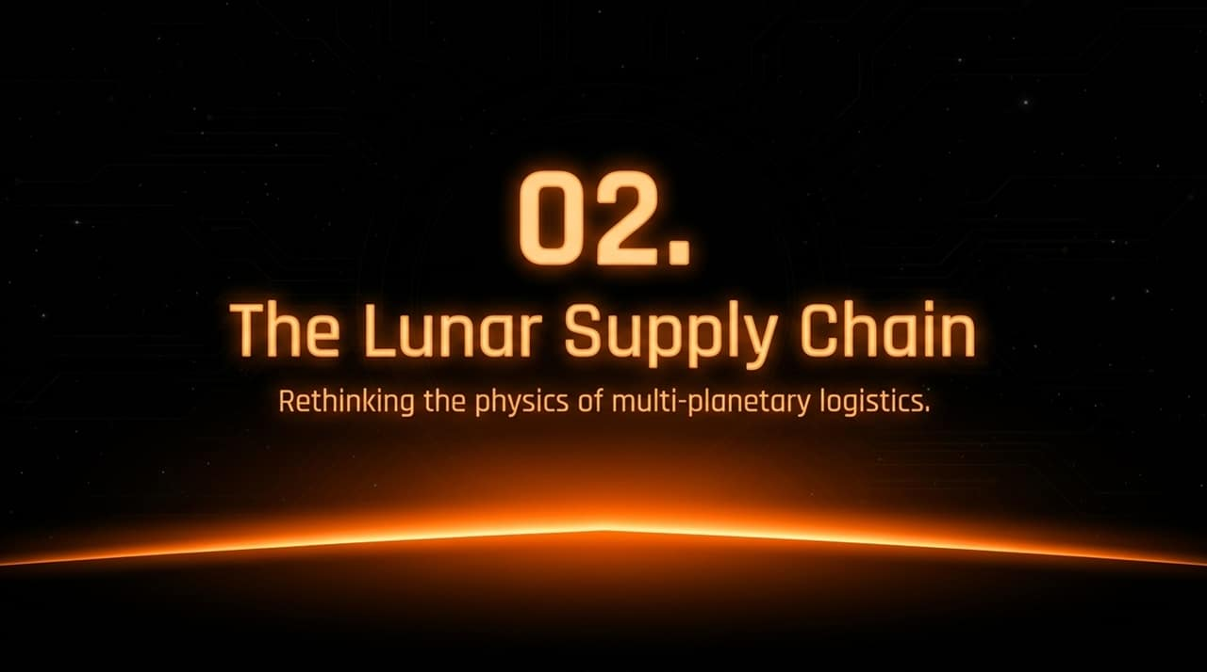
Notes:
Transition to the Physical Bottleneck:
Once intelligence is ubiquitous and cheap, the next constraint to solve is matter—how we build heavy physical infrastructure.
The Multi-Planetary Challenge:
Establishing a self-sustaining human presence on Mars or in orbit requires millions of tons of structural materials, habitat shells, and fuel.
Rethinking Space Logistics:
If we attempt to launch all of that heavy payload directly from Earth’s surface using traditional chemical rockets, the economics simply do not close.
The Strategic Shift:
The Moon is not just a destination; it is an industrial staging ground and supply chain cheat code.

Slide 7
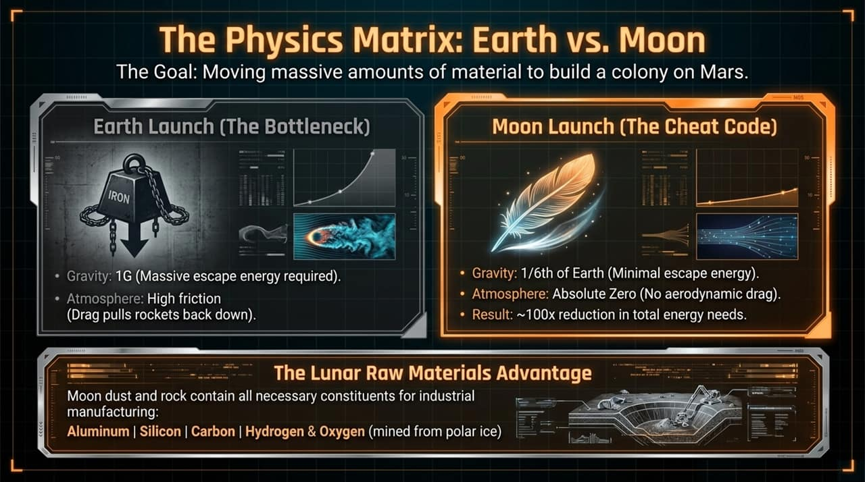
Notes:
Earth Launch (The Bottleneck):
When launching from Earth, rockets fight two massive physical friction points:
$1\text{G}$Gravity: Requires massive propellant tanks just to lift the fuel itself.
Thick Atmosphere: Aerodynamic drag creates friction and pushes back down on the vehicle, consuming huge energy reserves.
Moon Launch (The Cheat Code):
By shifting the raw manufacturing hub to the lunar surface:
$1/6\text{th}$Earth Gravity: Decreases the energy required to escape the gravity well.
Zero Atmosphere: Eliminates drag friction entirely.
Result: Moving heavy matter from the Moon reduces total energy requirements by $∼100×$compared to launching from Earth.
Lunar Raw Materials Advantage:
The Moon's surface is rich in essential industrial elements: Aluminum, Silicon, Carbon, plus Hydrogen & Oxygen extracted from polar water ice to synthesize fuel and water systems.

Slide 8
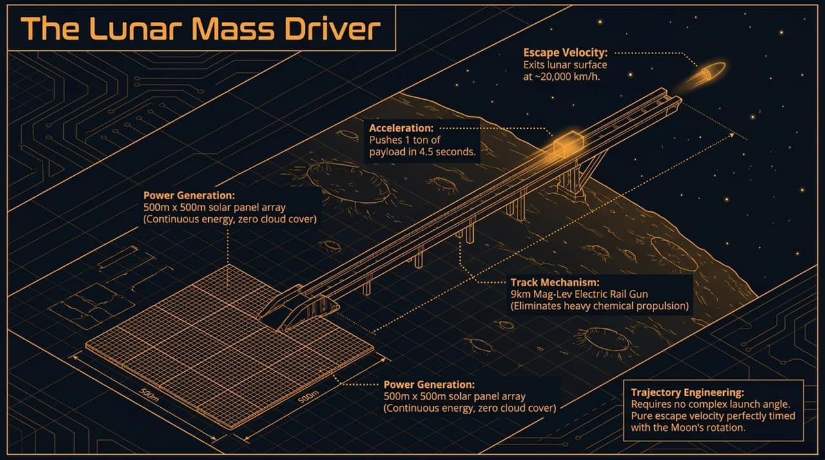
Notes:
Concept:
Since the Moon has no atmosphere, we don't need chemical rocket launches for logistics. We can use an electromagnetic mass driver.
Key Specifications & Engineering:
$9 \text{km}$Mag-Lev Track: A horizontal electric rail gun running along flat lunar terrain.
Solar Array Power: Powered by a $500\text{m}×500\text{m}$solar panel array paired with capacitors, taking advantage of continuous sunlight with zero cloud interference.
High-Speed Acceleration: Accelerates a 1-ton payload to lunar escape velocity ($∼20,000 \text{km}\text{/}\text{h}$) in just $4.5 \text{seconds}$.
Trajectory Engineering:
No complex launch angles are required. The payload is released horizontally at escape velocity, perfectly timed with the Moon's rotation to direct it toward Mars or Earth orbit.

Slide 9
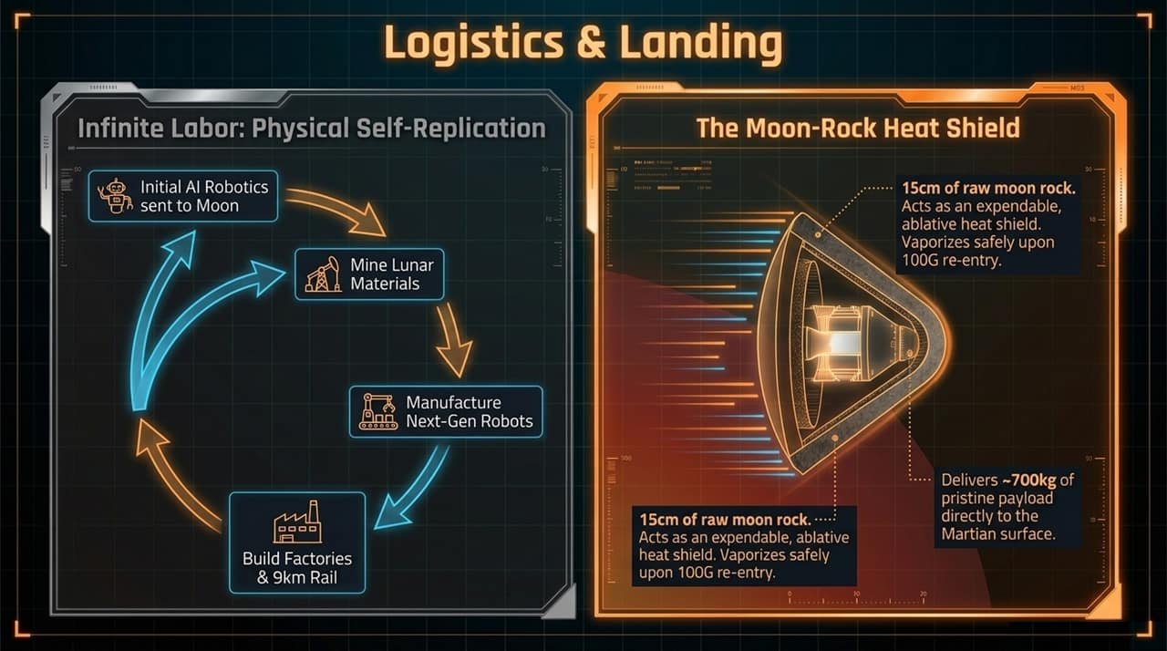
Notes:
Infinite Labor – Physical Self-Replication:
To build this infrastructure without sending thousands of human workers, we rely on physical self-replication:
Send an initial seed of AI-driven autonomous robotics to the Moon.
Robots mine local lunar regolith and construct next-generation units.
Secondary robotics build the solar arrays, processing plants, and the $9\text{km}$rail system.
Logistics & Landing (The Moon-Rock Heat Shield):
How do payloads enter atmospheric bodies like Mars or Earth safely?
Instead of heavy engineered heat shields, payloads are wrapped in $15 \text{cm}$of raw moon rock.
During atmospheric re-entry at $100\text{G}$s of acceleration, the sacrificial moon rock ablates and vaporizes safely, delivering $∼700 \text{kg}$of pristine payload straight to the surface.

Slide 10
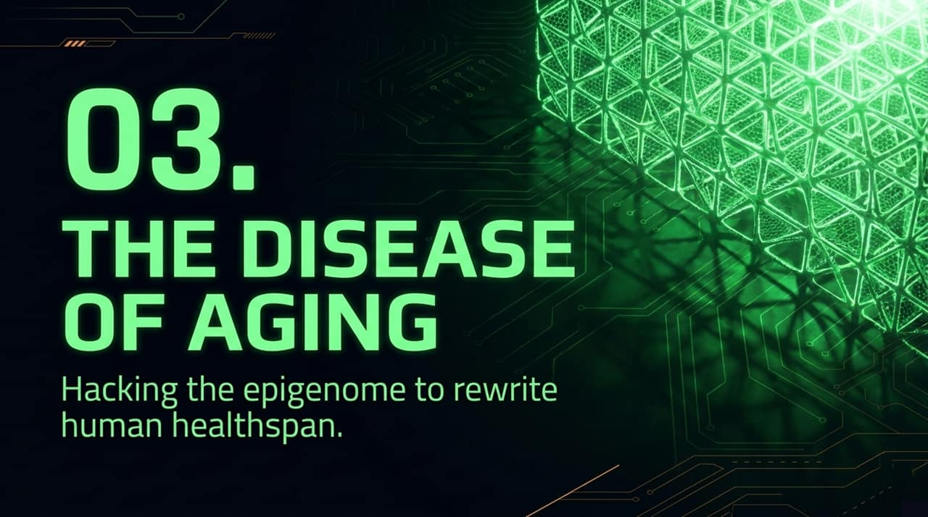
Notes:
Transition to the Biological Bottleneck:
We’ve addressed digital limits with edge AI, and physical limits with lunar mass drivers. The final bottleneck is human longevity.
Redefining Aging:
For millennia, aging was viewed as an inescapable natural process. Modern longevity science treats aging as a treatable disease caused by cellular data degradation.
The Promise:
If we can fix the epigenetic software errors in human cells, we can extend healthy lifespan, prevent age-related chronic diseases, and dramatically increase human agency.

Slide 11
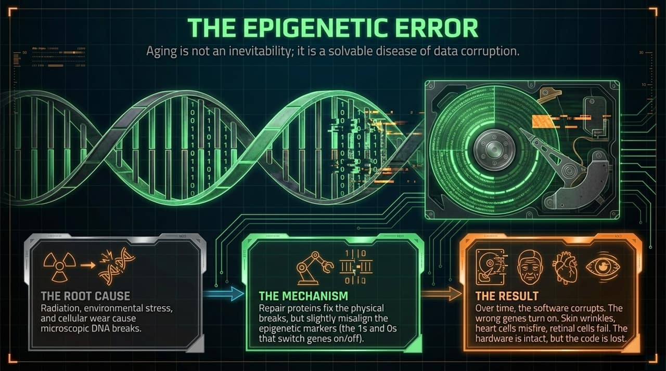
Notes:
The Computer Hardware/Software Analogy:
Think of human DNA as the raw hard drive, and the epigenome as the operating system (the 1s and 0s determining which genes turn ON or OFF).
The Root Cause:
Throughout life, radiation, oxidative stress, toxins, and metabolic waste cause micro-breaks in our DNA strands.
The Mechanism of Decay:
Cellular repair proteins quickly fix physical breaks. However, each time a repair occurs, surrounding epigenetic markers drift slightly out of position.
The Result:
Over decades, this 'epigenetic noise' corrupts cellular instructions. The hardware (DNA) remains mostly intact, but the software fails. Skin cells lose structural integrity, heart cells misfire, and retinal cells degrade.

Slide 12
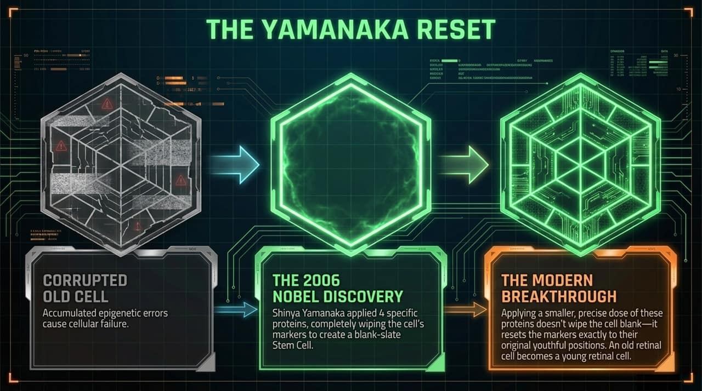
Notes:
The 2006 Nobel Discovery:
In 2006, Dr. Shinya Yamanaka discovered four transcription factors (proteins) that wiped a cell’s epigenetic markers completely, converting an old specialized cell back into a blank-slate pluripotency stem cell.
The Modern Breakthrough (Partial Reprogramming):
Turning mature tissue into stem cells inside a living organism causes tumors.
Recent breakthroughs discovered that applying a controlled, lower dose of Yamanaka factors resets the epigenetic markers back to their original youthful positions without erasing the cell’s identity.
Validation & Trial Proofs:
An old retinal cell stays a retinal cell—it simply functions like a young one again.
This technique extended mouse lifespans equivalent to >200 human years, reversed blindness in primates, and is currently undergoing clinical trials in humans.

Slide 13
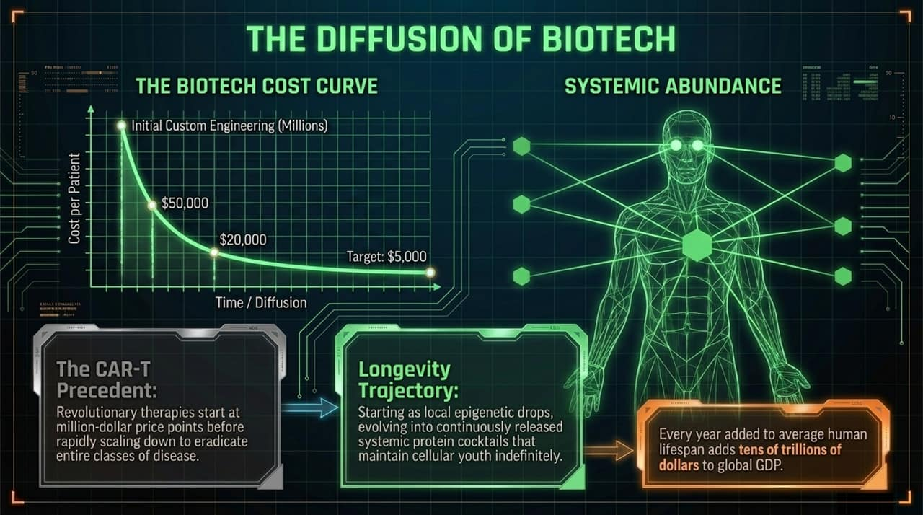
Notes:
Biotech Cost Curve (The CAR-T Precedent):
Advanced therapeutics start out expensive. When CAR-T cell cancer therapy first launched, it cost millions per patient due to complex custom cell isolation.
As manufacturing processes standardise, prices drop exponentially—from $\$1\text{M}→\$50\text{k}→\$5\text{k}$, turning boutique treatments into routine cures.
Longevity Trajectory:
Epigenetic resetting will follow the exact same curve: starting with local targeted drops (e.g., treating glaucoma) before evolving into continuous, systemically released protein cocktails.
Economic Impact:
Adding just 1 year of healthy human lifespan adds tens of trillions of dollars to global GDP through retained expertise, productivity, and reduced healthcare costs.

Slide 14
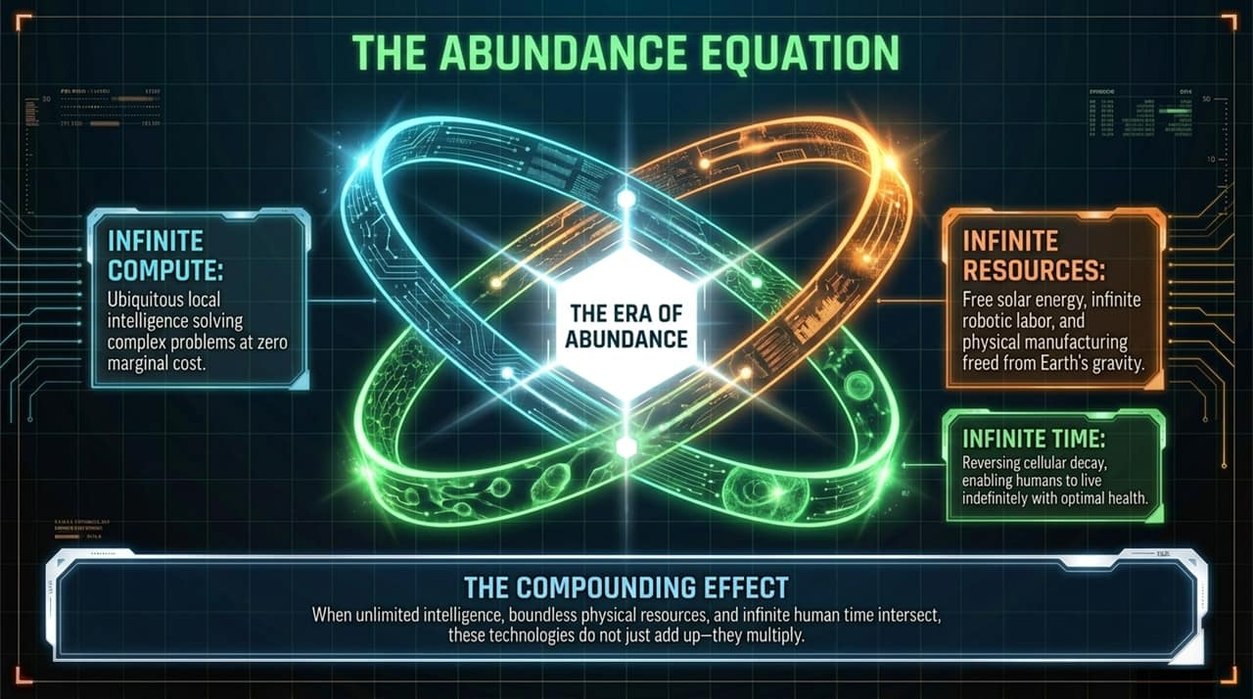
Notes:
Putting it All Together:
When we look at these three vectors, we realize they do not act in isolation—they multiply.
The Equation Components:
Infinite Compute: Ubiquitous local AI solving complex science, engineering, and logistics problems at near-zero marginal cost.
Infinite Resources: Boundless solar energy and physical manufacturing freed from Earth's gravity well via lunar logistics.
Infinite Time: Eradicating cellular decay and age-related disease, allowing humans to live healthy, productive lives indefinitely.
Conclusion:
History proves technology diffuses. Abundance is no longer an abstract theoretical question of if, but an engineering timeline of when.

Slide 15
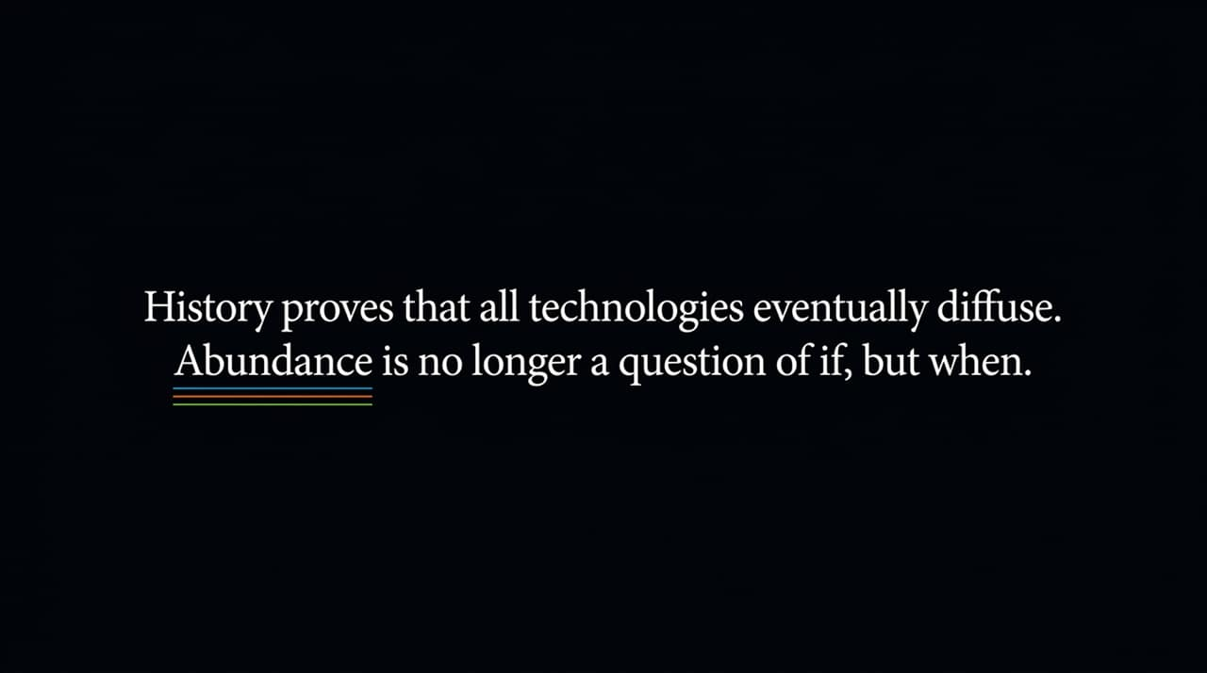
Notes:
Recap of Core Principles:
Digital Layer: Local model execution and agentic auto-research are breaking cloud compute monopolies.
Physical Layer: Lunar gravity ($1/6\text{th}$) and mass driver propulsion reduce off-world logistics costs by $100×$.
Biological Layer: Controlled Yamanaka factor dosing repairs the epigenome, targeting root-cause aging rather than just symptoms.
Key Lesson:
High initial price tags and centralized bottlenecks are temporary phases in tech evolution. Market forces drive rapid commoditization.

Slide 16
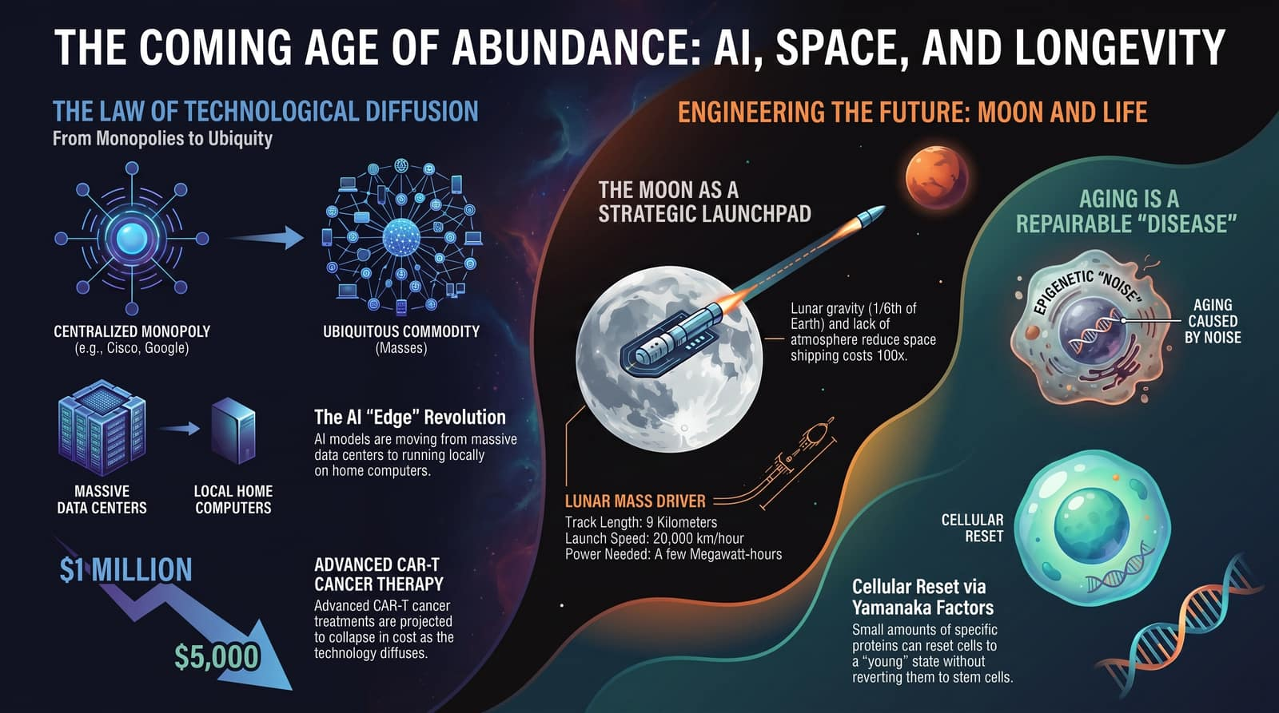
Notes:
Final Thoughts:
We are transitioning from an economy defined by scarcity to an economy defined by abundance.
Capital, labor, energy, compute, and health are shifting from rare commodities into cheap, scalable software and robotic operations.
Call to Action / Q&A Prompt:
The leaders, investors, and builders of tomorrow will be those who stop designing for constraints and start building for abundance.
Thank you, and I am now happy to open the floor to questions.

